Slide 1

Are Your SQL Servers Actually Secure?
Six areas of vulnerability that every database professional should review
Mike Walsh & Jeff Iannucci

Slide 2
Are you secure? Are you prepared?
Pick a number between 1 and 10 to indicate your confidence level that your SQL Server instances are secured.
Please drop your number in the comments.

Slide 3
Are you secure? Are you prepared?
“While half of organizations feel ‘very prepared’ to face ransomware, 78% experienced ransomware attacks last year…”
“…and fewer than 25% achieved recovery within a day…”
“…83% of organizations that paid ransoms were attacked again…”
“…93% lost data regardless of payment.”
– CrowdStrike State of Ransomware 2025 survey results
https://go.crowdstrike.com/State-of-Ransomware-Survey.html

Slide 4
Six areas of security vulnerabilities
Platform Readiness
Access Control
Privilege Escalation
Code and Command Execution
Data Protection
Detection and Forensic Readiness

Slide 5
Platform readiness
Have you set up everything outside of the databases properly?
Supported versions of Windows and SQL Server
Regularly applying updates
Current or deprecated TLS or SSL protocols
NTLM or Kerberos authentication
SPN registration for SQL Server service account
Can I ping your server?

Slide 6
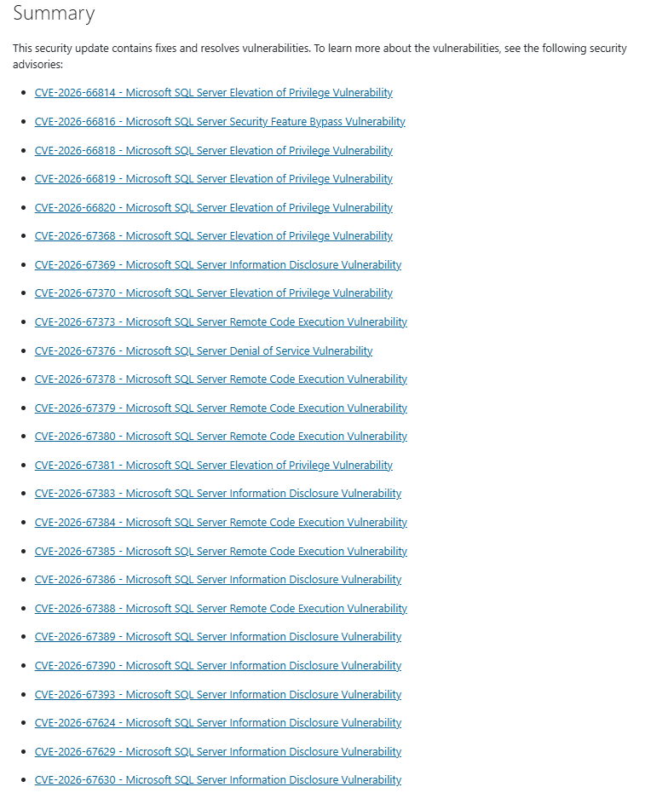
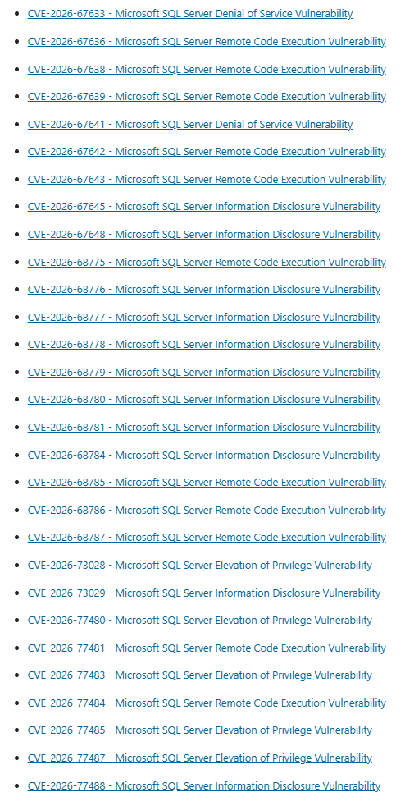
The most recent update (September 8, 2026)

Slide 7
Access Control
Did you leave the front door open?
Is the sa login disabled (or enabled and monitored for usage)
Windows accounts/groups or SQL Server login authentication
Weak or strong passwords for SQL Server logins
Legacy or modern password hash for SQL Server logins
Guest user permissions

Slide 8
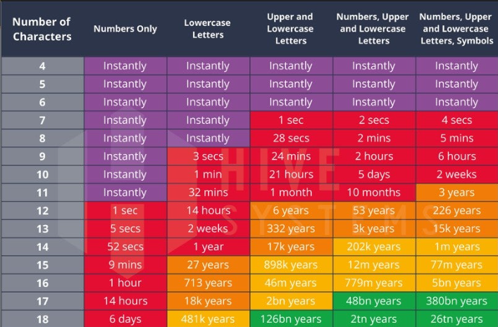
What is a strong password?
(Consider the differences, not the literal values)

Slide 9
Privilege Escalation
Have you set up adhered to the Principal of Least Privilege?
Review of sysadmin, securityadmin, serveradmin roles
Review of local Administrators
CONTROL SERVER permission
TRUSTWORTHY database
Linked servers using fixed logins
Service accounts in sysadmin or local Administrators
SQL Agent proxy accounts

Slide 10
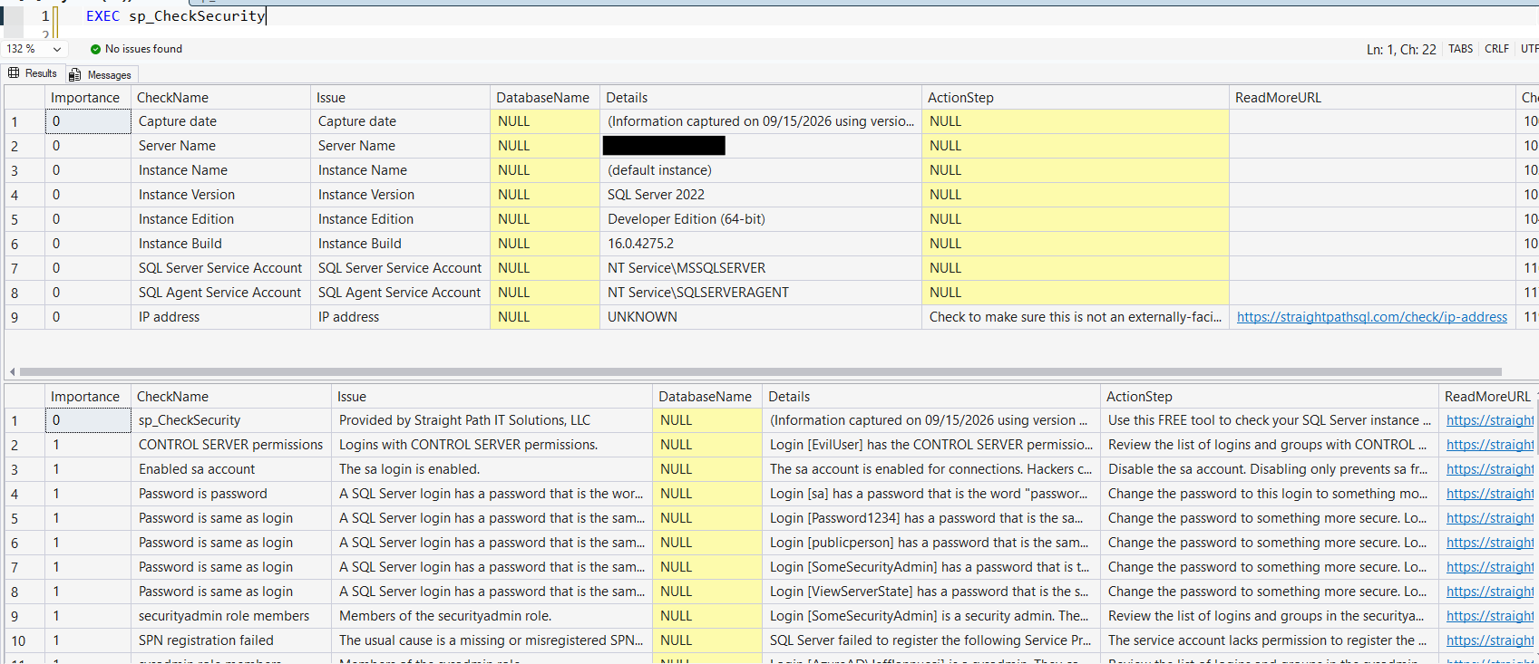
sp_CheckSecurity is FREE

Slide 11
Code and Command Execution
But…why?
xp_cmdshell
Ole Automation Procedures
CLR enabled without CLR Strict Security
External scripts (Python, R, Java)
SQLAgentOperatorRole
Startup stored procedures
Logon triggers

Slide 12
Data protection
Assume a breach has occurred!
Backups verified with CHECKSUM
Backups encrypted
Backup location permissions
Certificates and master keys backed up
Regular DR testing
Can backup copies survive a compromise of the SQL Server service account?

Slide 13
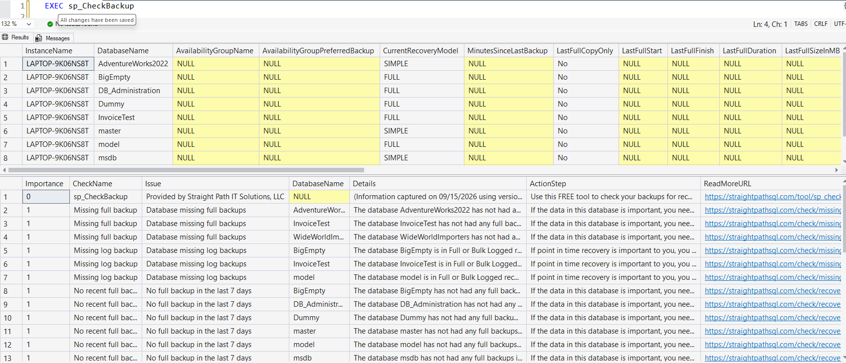
sp_CheckBackup is FREE

Slide 14
Detection and Forensic Readiness
Think “detect and contain” – Andreas Wolter
Capturing failed logins
Error log retention
Default trace enabled
Audit capturing security-relevant actions
  SERVER_ROLE_MEMBER_CHANGE_GROUP
  SERVER_PERMISSION_CHANGE_GROUP
  SERVER_PRINCIPAL_CHANGE_GROUP
  AUDIT_CHANGE_GROUP

Slide 15
Are you secure? Are you prepared?
Would you still pick the same number between 1 and 10 to indicate your confidence level that your SQL Server instances are secured?
If it went down, that's not bad news.
Now you know more about what to ask.

Slide 16
A quick word about us
Straight Path Solutions: SQL Server DBA as a Service, Consulting, CDO and Data Architecture work. 15 DBA types.
125+ clients, including several credit unions
Mike Walsh (Founder): about 30 years in tech most of it as a DBA or consultant. Blogger/Speaker/Former 9-Year MVP
Jeff Iannucci (Principal Consultant): also about 30 years in tech most of it as a DBA or consultant. Blogger/Speaker/Author/sp_Check dude

Slide 17
Be secure. Be prepared.
Do It Yourself: Free sp_CheckSecurity, $0. Run it this week.
https://straightpathsql.com/sp_check/sp_checksecurity/
Let Us Check It: SQL Server Health Check, $997. We look, we score it, we prioritize what matters.
Help Us Own It: DBA as a Service. If coverage is the real problem, let's talk.
Option one is a perfectly good option. It's why we give the tools away.

